Slide 1
Software Engineering Project / MAIA Master
Group:
Antoine Merlet, Gülnur Ungan, Mladen Rakic, Marcio Rockenbach
Professors:
Dr. Yohan Fougerolle, Dr. Cansen Jiang, Dr. David Strubel

Slide 2
Table of Contents
Introduction
Choices / Target
Project Management
Results
Future Work
Conclusion
Statistics

Slide 3
Introduction
Context
Current state

Slide 4
Choices / Target
Organization of the code
Interfacing
Documentation
Variety of choices
GUI

Slide 5
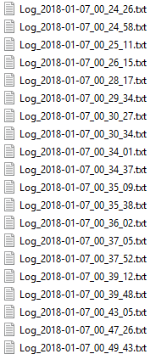

Logger
Debug feature
Singleton design
Signal / slots
Easiness of use

Slide 6
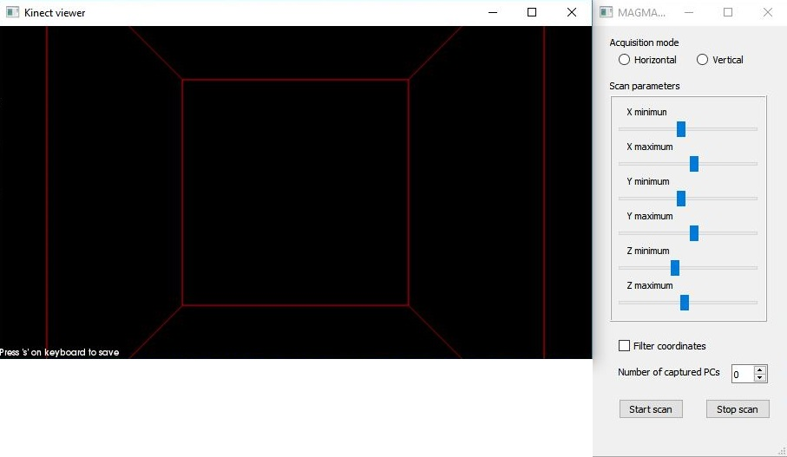
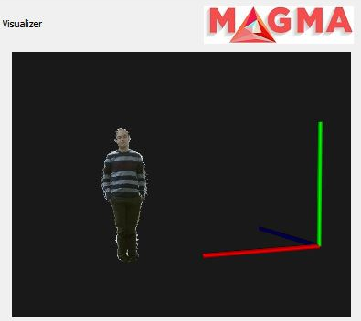
Input / Output
Kinect2grabber
Live Scan on PCL Visualizer Widget
Point cloud display on VTK Widget

Slide 7
GUI
Simplicity
Power
Diversity
Organization
Main window
Scan window
Filter window
Register window

Slide 8
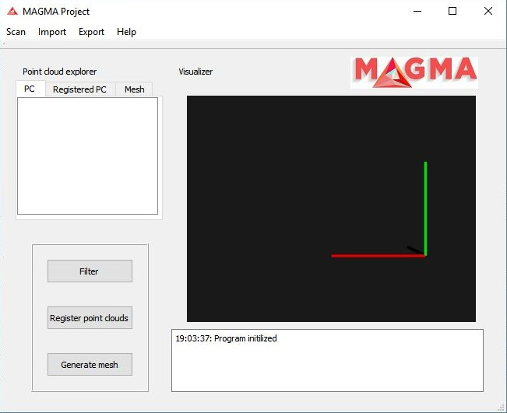
GUI – Main window

Slide 9
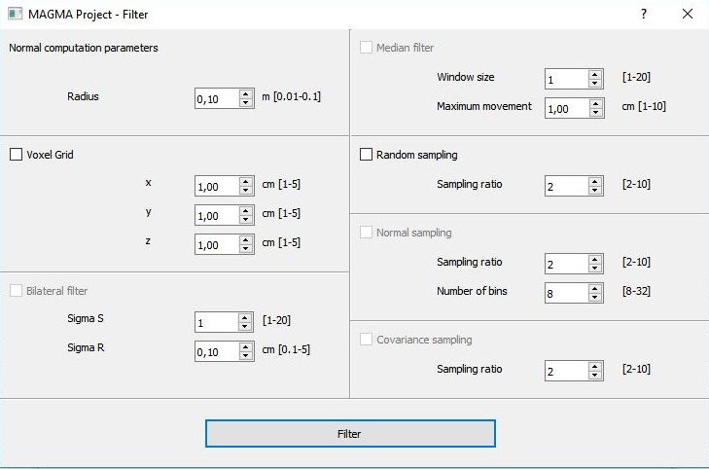
GUI – Filtering window

Slide 10
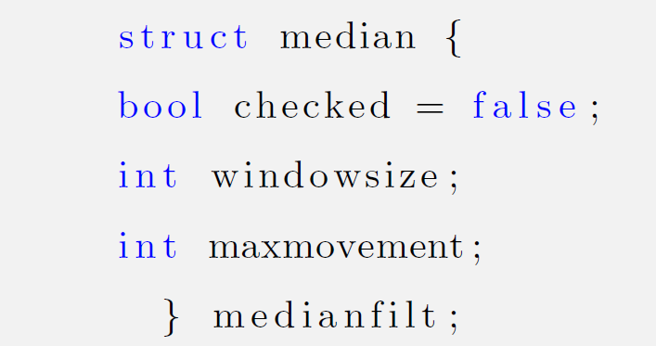
GUI – Example

Slide 11
Future Work
Meshing
Good parameters
Redirect std::cout to logger
Horizontal / Vertical acquisition modes
Configuration files
Full screen logger
Functional bounding box
Integrate capture -> display point clouds
SQL database

Slide 12
Conclusion
Challenging Project
Focus:
- Perfect Software
+ Project design and coding habits
Results achieved
Good starting point for next year’s students

Slide 13
Thank you!

